Slide 1
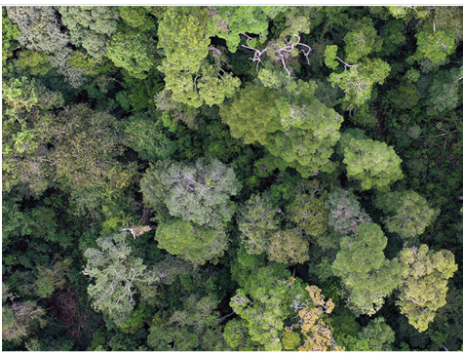
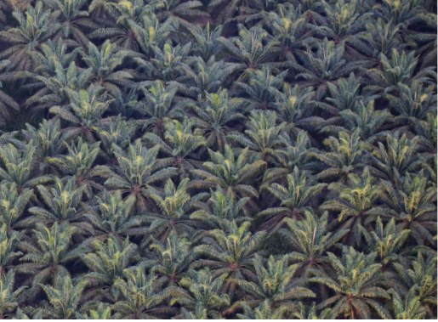
Functional Diversity and Ecosystem Functions

Slide 2
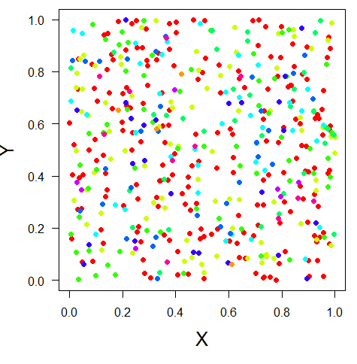
Any measure of diversity only captures part of the picture
α, richness, evenness, diversity entropy
β, similarity, distance decay
γ, SAR, EAR, etc

Slide 3
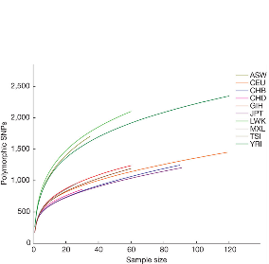
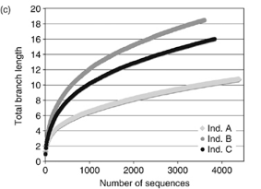
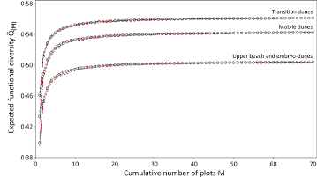
What about other biodiversity facets?
Genetic diversity
Phylogenetic diversity
Functional diversity

Slide 4

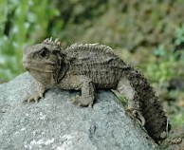
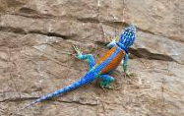

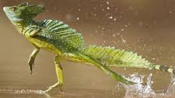
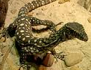
Which community is more diverse?

Slide 5
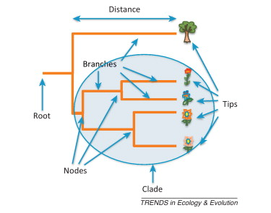
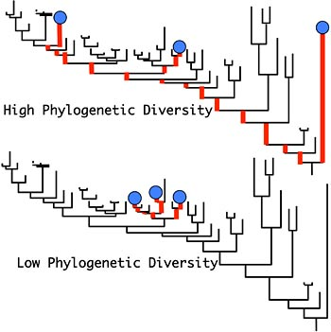
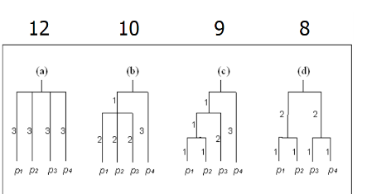
Phylodiversity=sum of branch lengths (Faith 2002)

Slide 6
Tucker et al. 2016

Slide 7
Two main uses of phylogenetic diversity measures
Explore evolutionary patterns (sometimes in the context of conservation)
As ‘proxy’ for niche similarity ideas (e.g., phylogeny = function)

Slide 8
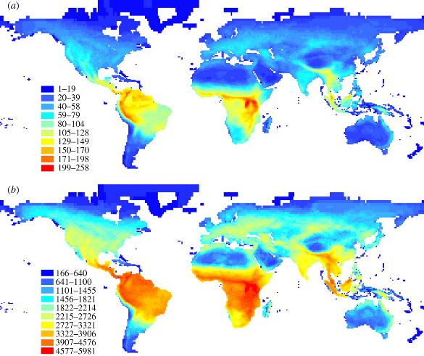
Mammals
—taxonomic diversity
--Phylogenetic
diversity
Davies and Buckley 2011

Slide 9
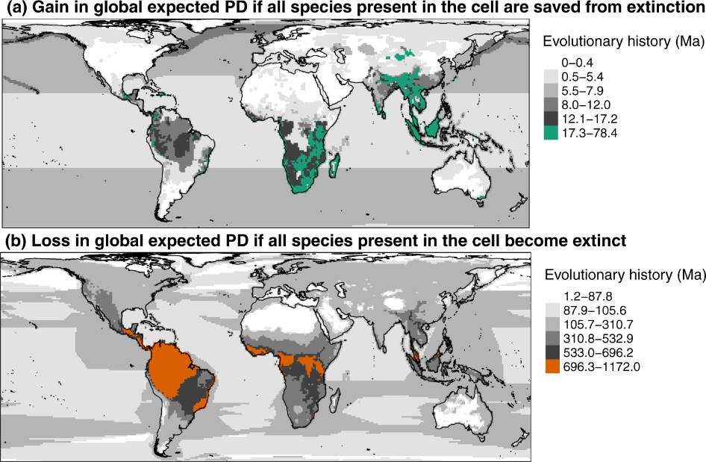
Robuchon et al. 2021 Nature Communications

Slide 10
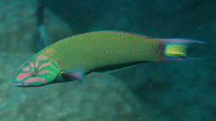
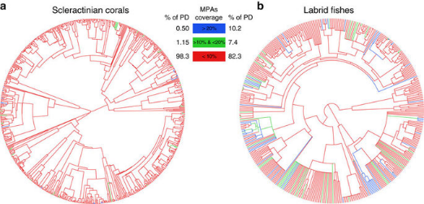
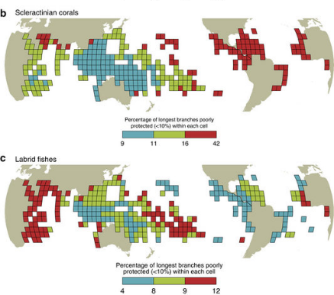
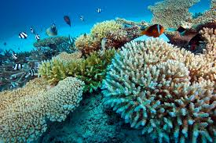
Mouillot et al. 2016

Slide 11
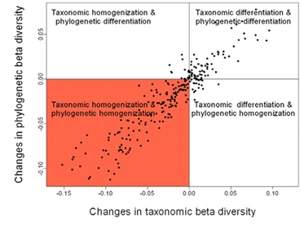
Winter et al. 2009

Slide 12
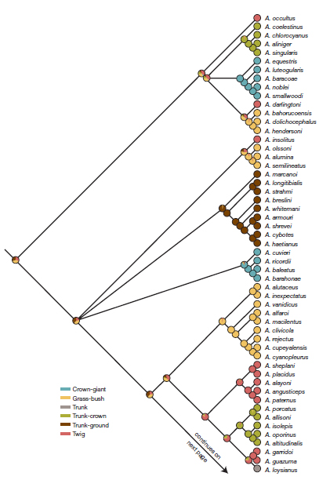
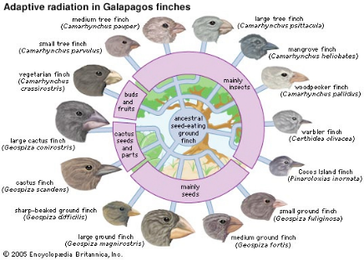
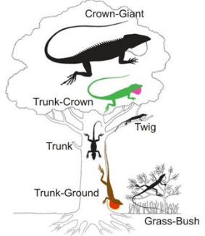
Correlation between traits and phylogenies?
Losos 2005

Slide 13
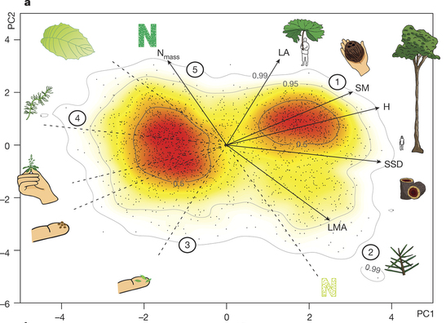
What about functional traits?
Diaz et al. 2016

Slide 14
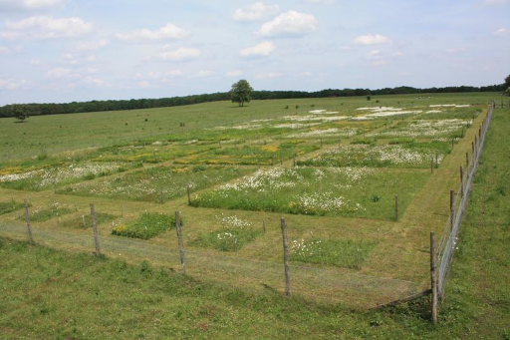
Comparing taxonomic and functional patterns
Fukami et al. 2005

Slide 15
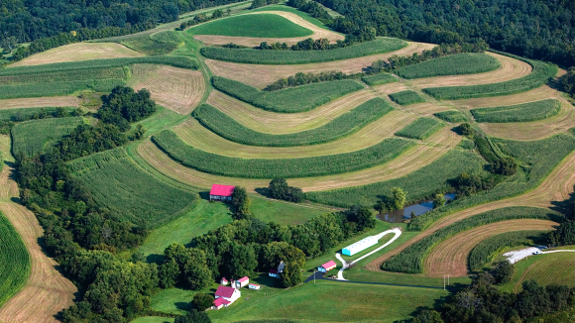
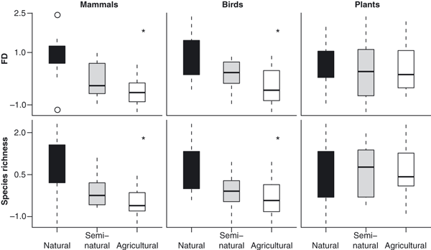

Slide 16

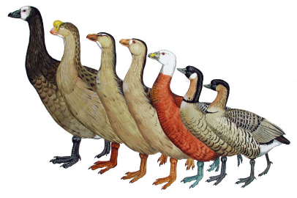
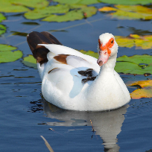
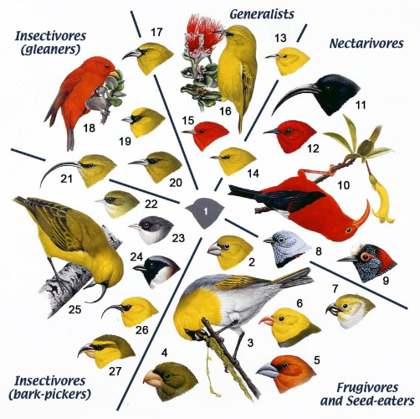
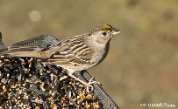
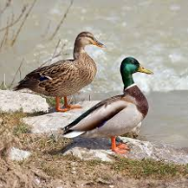
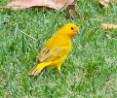
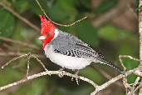
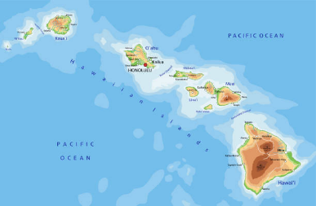




Slide 17
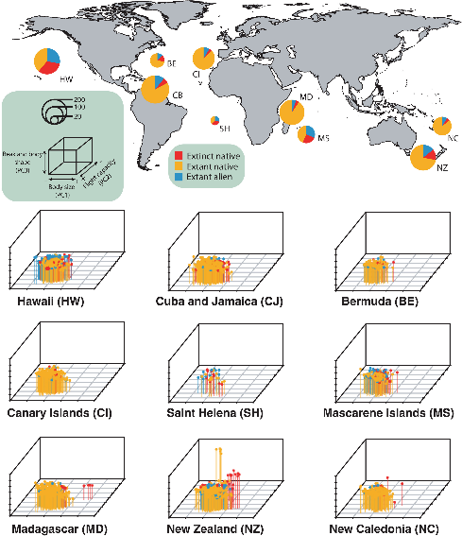
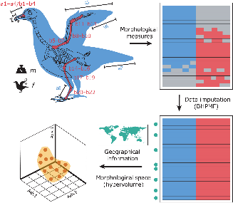
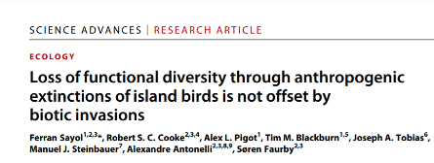

Slide 18
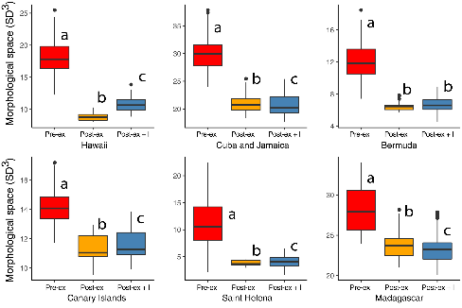
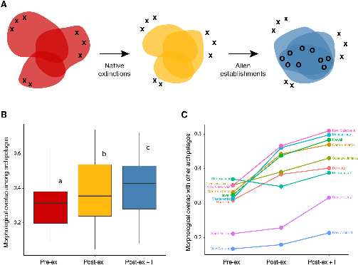

Slide 19
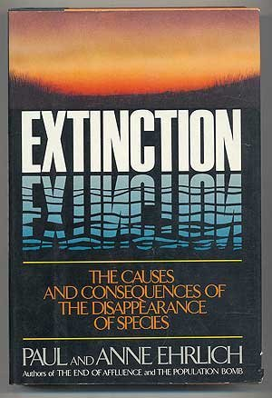
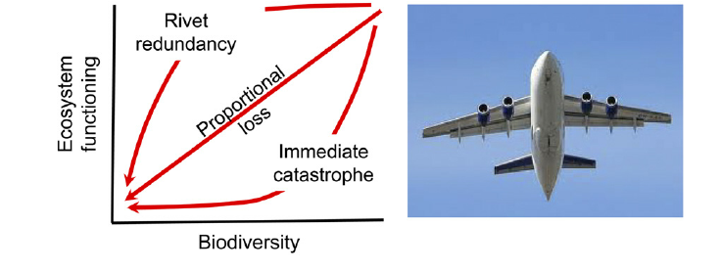

Slide 20
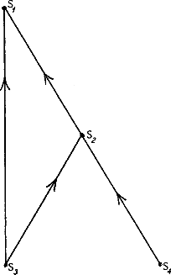
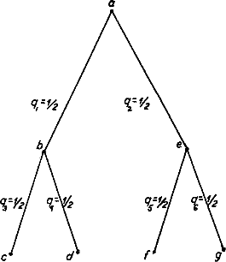
Biodiversity and Ecosystem Stability
“simple communities were more easily upset than that of richer ones; that is, more subject to destructive oscillations in populations, and more vulnerable to invasions”
C. Elton 1958
MacArthur 1955

Slide 21
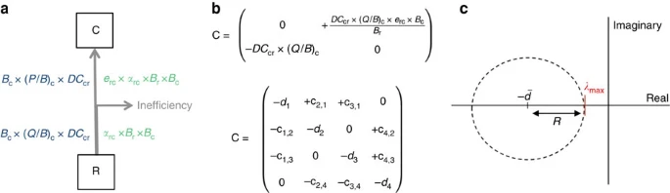
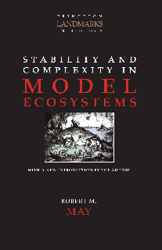
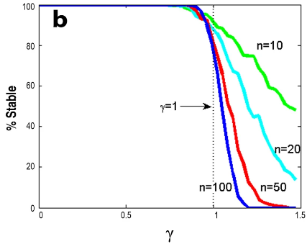
Stone 2018

Slide 22
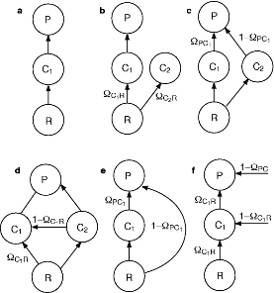
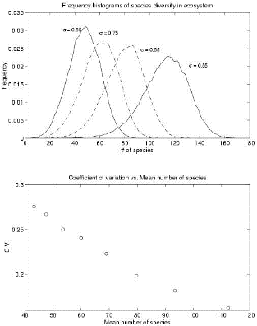
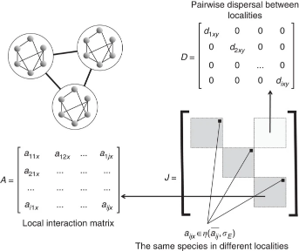

Slide 23

Understanding diversity–stability relationships: towards a unified model of portfolio effects
Thibault and Connolly 2013

Slide 24

No complexity–stability relationship in empirical ecosystems Jaquet et al. 2016. Nature Communications

Slide 25

Multiple facets of biodiversity drive the diversity–stability relationship
Craven et al. 2018

Slide 26


Ecosystem Models Ignore Species and Their Diversity

Slide 27


“A greater absolute amount of life can be supported…when life is developed under many and widely different forms,…the fairest measure of the amount of life being probably the amount of chemical composition and decomposition within a given period.”

Slide 28



1990-2000s—BEF becomes an idea

Slide 29


2010-2020s—BEF as a paradigm
Cardinale et al.
Hooper et al.

